Slide 1

Macros in Scala: Compile-Time Code Generation
Understanding why macros matter and how they transform the way we write Scala programs

Slide 2
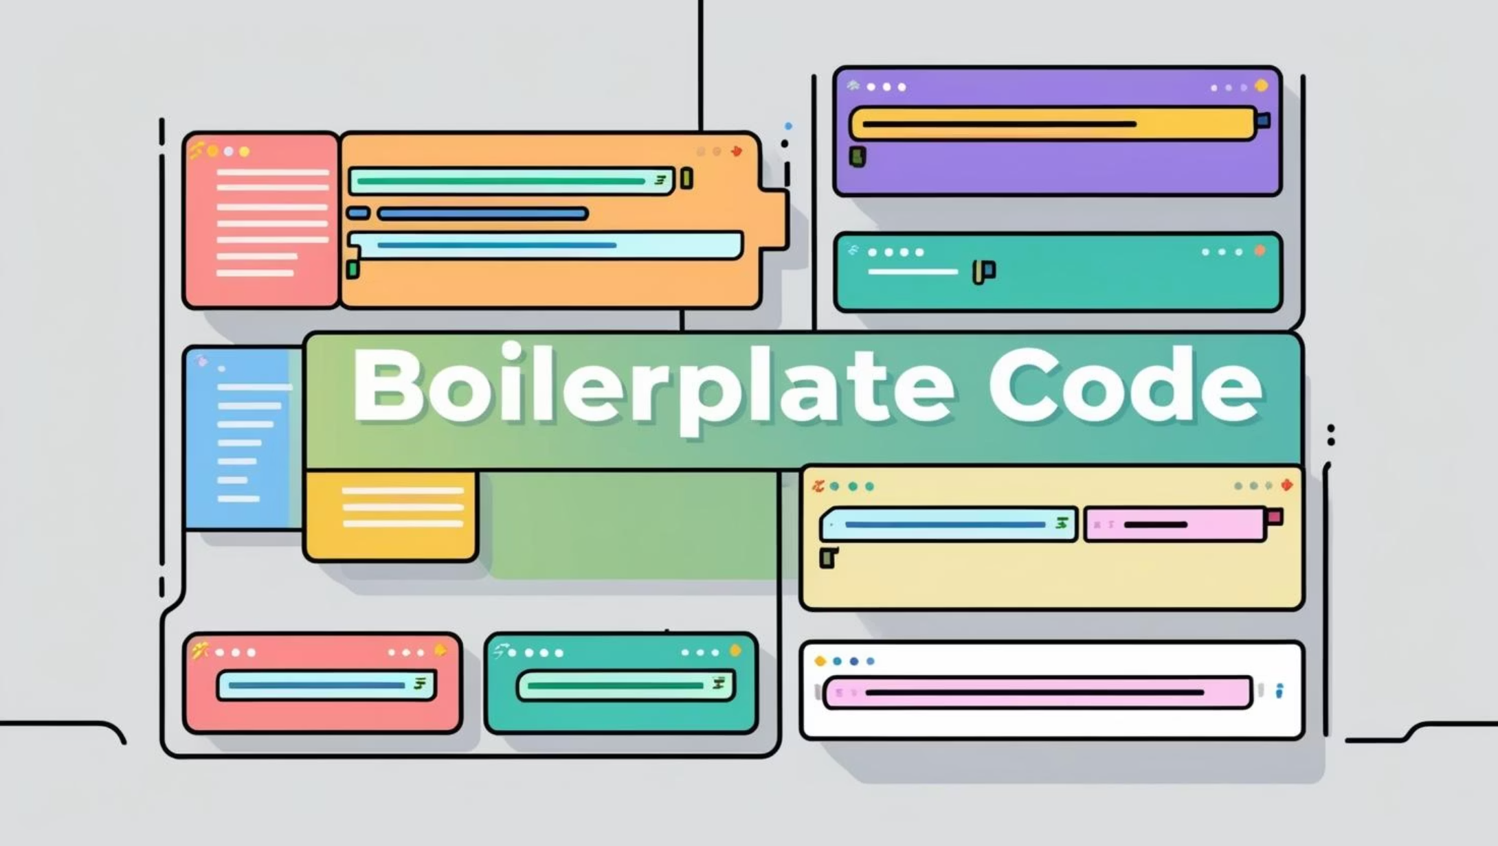
PROBLEM
Why Scala Needs Macros
In large Scala projects, developers face recurring challenges that impact code quality and performance. We write repetitive boilerplate code that clutters our codebase. Runtime reflection, while powerful, introduces slowness and type-safety risks. Many errors only surface when the program is already running in production.
Macros solve these problems by moving logic into the compiler itself. Errors appear during compilation rather than at runtime. Performance improves because work happens once during build time, not repeatedly during execution.

Slide 3
DEFINITION
What Is a Macro?
01
02
Compiler reads source code
Macros are expanded
The compilation process begins by parsing your Scala files
Macro programs run, receiving code as input and generating new code as output
03
04
Generated code is type-checked
Bytecode is produced
The compiler validates the newly created code for correctness
Final compilation produces executable bytecode with zero runtime cost
A macro is a program that runs during compilation. It receives Scala code as input and generates new Scala code as output. Crucially, macros don't run business logic—they create the code that will run later at runtime. Because macros exist only during compilation, they add no runtime overhead.

Slide 4

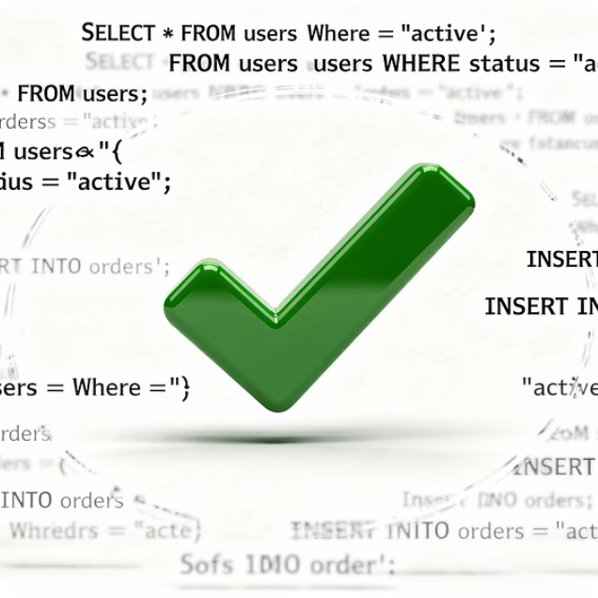


BENEFITS
Real-World Impact and Applications
Compile-Time Validation
Zero-Cost Abstractions
Automatic Boilerplate
Check SQL queries, regular expressions, and configurations before the program runs, catching errors early
Create logging and debugging tools that disappear when disabled, with no runtime overhead
Generate large amounts of repetitive code automatically without manual effort or runtime cost
Leading Scala libraries leverage macros extensively. The Scala standard library, ZIO, Circe, and Shapeless all use macros to generate type-safe, efficient code while maintaining simple, elegant APIs for developers.

Slide 5
KEY CONCEPT
Two Worlds, One Scala: Phase Separation
Runtime Phase
Compile-Time Phase
Normal Scala syntax dictates the logic and behavior executed when your program runs. This is where business rules, data processing, and user interactions take place. The compiler ensures type safety based on this syntax before execution begins.
Macro syntax operates entirely during compilation. It generates new Scala code based on your input, performing advanced transformations and optimizations. This code is then integrated and type-checked, existing only to produce the efficient runtime code.
This clear separation allows for powerful compile-time optimizations and code generation without imposing any runtime overhead. It ensures that the core logic remains readable and focused on solving business problems, while macros handle the heavy lifting of boilerplate and metaprogramming at build time.

Slide 6
Scala vs Zig: Different Approaches to Compile-Time Programming
Zig's comptime
Scala's Macros
Normal code runs at compile time
Simple and intuitive approach
Any runtime code can become compile-time code
Less separation between phases
Typed syntax trees with explicit macro syntax
Clear phase separation
More complex but safer
Structured metaprogramming with type guarantees
Both approaches solve similar problems but with different philosophies. Zig prioritizes simplicity and uniformity. The same code works at both compile time and runtime. Scala prioritizes safety and structure. Explicit syntax trees and phase separation prevent many classes of errors. The choice reflects each language's core values: Zig's pragmatic simplicity versus Scala's type-safe rigor.

Slide 7
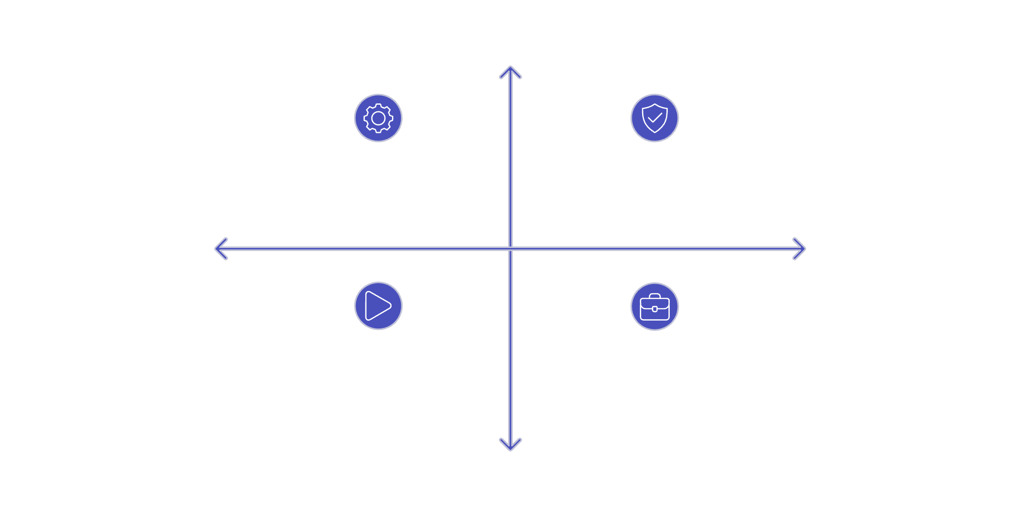
CONCLUSION
Trade-offs and Best Practices
High Compile-time Control
Limitations to Consider
Cannot access runtime data or perform I/O operations
Increase compilation time and codebase complexity
Should be used carefully, only when simpler solutions fall short
Compile-time: Macro Syntax & Codegen
Compile-time: Type Safety & Checks
Low Runtime Complexity
High Runtime Complexity
Runtime: Normal Syntax & Execution
Runtime: Business Logic & Effects
Conclusion
In summary, macros allow Scala to move work from runtime to compile time, improving safety, performance, and expressiveness when used correctly.
Low Compile-time Involvement
Scala uses one language with two phases. Normal syntax describes runtime behavior. Macro syntax describes compile-time code generation. This separation maintains clarity and safety.

Slide 8
Code
Macro Code
Expr:
This is not an Int.
It is code that will produce an Int. The macro receives the syntax, not the value.
Quotes:
This gives access to the compiler context.
It allows:
Reading syntax trees
Generating code
Emitting compile-time errors
Accessing types
Without this, the function cannot be a macro.
def positiveImpl(value: Expr[Int])(using Quotes): Expr[Int] = {
value match {
case Expr(v) if v > 0 =>
value
case Expr(_) =>
quotes.reflect.report.error("Value must be a positive constant")
'{ 0 }
case _ =>
quotes.reflect.report.error("Value must be known at compile time")
'{ 0 }
}
}
report.error stops compilation. '{ 0 } is just a placeholder because the compiler requires a returned expression.

